Slide 1

Introduction to Mutual Funds

Slide 2

Disclaimer
Information contained in this presentation is as on September 30, 2022.
The information contained in this presentation is only for Educational and Awareness Purposes related to securities market .
This presentation is only for Educational and Investor Awareness Programs and shall not be used for any legal interpretations.
SEBI or Stock Exchanges or Depositories shall not be responsible for any damage or loss to any one of any manner from use of this material.
Suggestions or feedbacks, if any, may please be sent by mail to visitsebi@sebi.gov.in.
2

Slide 3
Flow of Presentation
What is a Mutual Fund ?
Structure of Mutual Fund
What is an Asset Management Company (AMC)?
How does a Mutual Fund Work?
Classification of Mutual Funds
Based on Structure
Based on Investment Objective
Investment Portfolio
Risk vs Return
Categorization of Mutual Funds
How to invest in Mutual Funds?
Centralized KYC
Mutual Fund investment procedure
Investment Modes in Mutual Funds
Mutual Funds
Plans – Growth vs Dividend Options
How to check information about the Mutual Funds (Offer Document)?
Risk-o-Meter
Mutual fund investment on behalf of minor and nomination details
3

Slide 4
What is a Mutual Fund (MF)?
Common pool of funds contributed by investors and invested in accordance to the objectives.
Investments are held in a trust of which the investors alone are the joint beneficial owners.
Trustees oversee the management by investment manager.
4

Slide 5
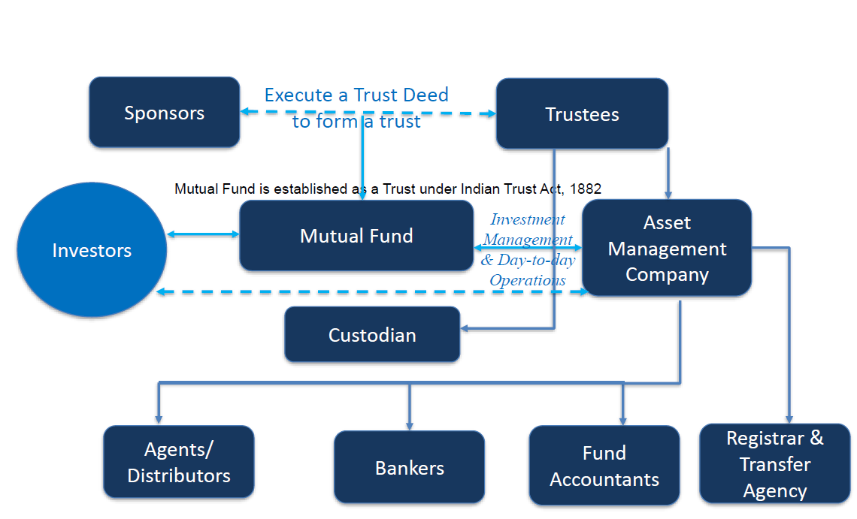
Structure of Mutual Fund
5

Slide 6
What is an Asset Management Company (AMC)?
Investment manager of the mutual fund.
Appointed by the trustees, with SEBI approval.
Trustees and AMC enter into an investment management agreement.
At least 50% of members of the board of an AMC have to be independent.
Required to invest seed capital of 1% of amount raised subject to a maximum of Rs.50 lakh in all open-ended schemes.
Should have a net worth of at least Rs.50 crore at all times.
AMC of one mutual fund cannot be an AMC or trustee of another fund.
AMCs cannot engage in any business other than that of financial advisory and investment management
6

Slide 7
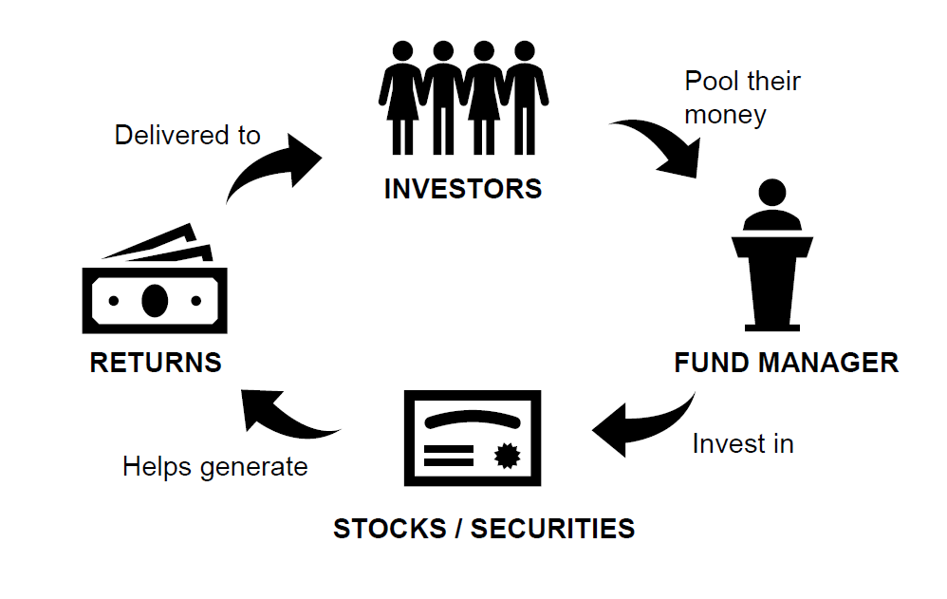
How does a Mutual Fund Work?
Pool of investors money.
Invested according to pre-specified investment objectives.
Benefits accrue to those that contribute to this pool.
There is thus mutuality in the contribution and the benefit.
Hence the name ‘mutual’ fund.
7

Slide 8
Classification of Mutual Funds
Classification of Mutual Funds
Based on Structure
Based on Investment Objective
Based on Investment Style
Open Ended Funds
Debt Funds
Passive Funds
Closed Ended Funds
Equity Funds
Active Funds
Interval Funds
Hybrid Funds
8

Slide 9
Classification - Based on Structure
Open Ended Funds
No fixed maturity date.
Closed Ended Funds
Run for a specific period.
Interval Funds
Variant of closed-ended funds.
Accept continuous sale and re-purchase requests.
Transactions are NAV-based.
Unit capital is not fixed.
Offered in an NFO but are closed for further purchases after NFO.
Unit capital is kept constant.
Becomes open-ended at specific intervals.
Have to be mandatorily listed.
9

Slide 10
Classification - Based on Investment Objective
Debt Funds
Equity Funds
Hybrid Funds
Invest in short and long term debt instruments.
Aim to provide regular income.
Invest in equity securities.
Aim to provide growth and capital appreciation over long term.
Invest in a combination of equity and debt securities.
Proportion of equity and debt may vary.
Aim to provide for both income and capital appreciation.
10

Slide 11
Classification - Based on Investment Style
Passive Funds
Active Funds
Replicate a market index.
Invest in same securities and in same proportion as that of index.
No active selection of any stock / sector.
Expenses are lower.
Portfolio is modified every time index composition changes.
Invests in securities and sectors that may offer a better return than the index.
Actively manage the allocation to market securities and cash.
May perform better or worse than the market index.
Incur a higher cost than passive funds.
11

Slide 12





Categorization of Mutual Fund Schemes
Categorization of open-end mutual funds:
To ensure uniformity in characteristics of similar type of schemes launched by different mutual funds.
Helps investors to evaluate different options available before making informed decision to invest.
Hybrid
Schemes
Debt
Schemes
Solution oriented
Schemes
Categorization of Mutual Fund Schemes
Equity
Schemes
Other
Schemes
12

Slide 13
How to invest in Mutual Funds?
Via Physical Mutual Fund Application Form
Via Online Mode (Website of Mutual Fund)
Via Mobile App of Mutual Fund
Via AMFI Registered Mutual Fund Distributor (using physical form/ online/ mobile app)
13

Slide 14
Centralized KYC (C-KYC) in Securities Market
KYC registration is centralized through KYC Registration Agencies (KRAs) registered with SEBI.
Each investor to undergo KYC process only once in securities market and details would be shared with other intermediaries by the KRAs.
Standard Account Opening form (AOF) has 2 parts:
  Part I : Basic and uniform KYC details of the investor
  Part II : Additional KYC information as may be sought separately by the Mutual Fund
14

Slide 15
Mutual Funds investment procedure
Indicate whether you are a First Time Investor/ Existing Investor.
Visit official website of KRA and check whether you are KYC compliant or not. You must submit this KYC status.
Provide your details like name, address, etc.
Submit Bank account details and copy of “Cancelled Cheque”.
Once documents are accepted by Mutual Fund Company, you may start making investment.
15

Slide 16
Investment Modes in Mutual Funds
Lump-sum Investment
Systematic Investment Plan (SIP)
One time investment.
Staggered Investment.
Usually, large sum of money is invested in one go.
Investor faces risk of volatility in markets.
Period of commitment - 6 months, 1 / 3 / 5 years.
Specific intervals - monthly, quarterly, half-yearly.
Made on specific dates e.g. 1st, 5th, 10th, 15th of every month.
16

Slide 17
Investment Modes in Mutual Funds
Direct Mutual Fund
Directly offered by fund house.
Regular Mutual Fund
Bought through an intermediary.
No involvement of third party agents – brokers or distributors.
No commissions and brokerage.
Have low Expense ratio (because of no commissions).
Intermediaries can be brokers, advisors or distributors.
High Expense ratio as there are commissions to pay.
Low NAV.
Return is lower due to a higher expense ratio
Commissions and brokerage paid.
Have high NAV.
Return is higher due to a lower expense ratio
17

Slide 18
Mutual Fund Plans – Growth vs Dividend Options
Growth Option
Dividend
Payout Option
Gains made in portfolio are retained and reflected in NAV.
Fund declares dividend from realized profits.
Realized profit/loss is treated as capital gains or loss.
No increase or decrease in number of units, except if units are purchased or sold, by the investor.
NAV falls after dividend payout to the extent of dividend paid.
Dividend Reinvestment Option
Dividend is re-invested in same scheme by buying additional units at ex-dividend NAV.
Number of units standing to the credit of the investor, increases each time a dividend is declared, and reinvested back into the scheme.
Amount and frequency varies and depends upon distributable surplus.
18

Slide 19
How to check information about
the Mutual Funds (Offer Document)?
Statement of additional information (SAI)
Contains generic and statutory information of mutual fund.
Scheme information document (SID)
Contains financial information of mutual fund.
Lays down rights of investor.
Investment objective.
Asset allocation.
Investment strategies.
Terms with regard to liquidity.
Fees and expenses.
Scheme type (open or closed end).
Other information relating to the scheme.
Other additional information.
19

Slide 20
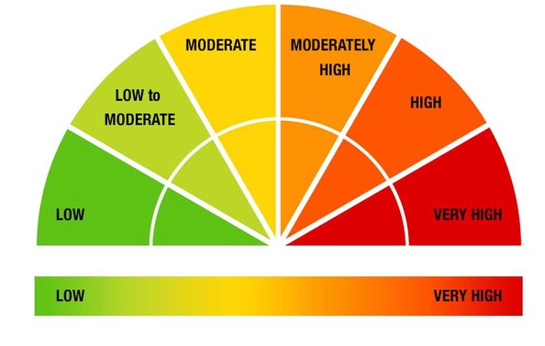
Risk-o-Meter and its importance
Six levels of risk for mutual fund schemes:
i. Low Risk
ii. Low to Moderate Risk
iii. Moderate Risk
iv. Moderately High Risk
v. High Risk and
vi. Very High Risk
Importance of Risk-o-meter :
Helps align risk that a fund carries with the risk profile of the investor.
Equity as asset class: Volatile: High risk
Debt as asset class: Stable: Low risk
Hybrid: Moderate: Depends on allocation and concentration
20

Slide 21
Nomination for Trading/Demat/Mutual Fund Units
Investor to get two options regarding nomination
  To provide nomination in the prescribed form up to three person along with their percentage
  Opting out of nomination through prescribed declaration form
Folios/Account to be freezed if none is opted till March 31, 2023
Applicable for opening new Demat account and trading accounts on or after October 01, 2021
Applicable for investor subscribing to mutual fund units on or after October 01, 2022.
For existing unit holder, AMC shall provide an option to submit
  In case of physical option, the form shall carry the wet signature
  In case of online option, AMC shall validate the form using e-Sign Or through two factor authentication (2FA)
21

Slide 22
Mutual Fund investment by Minor
Payment on behalf of minor shall be from
  Bank Account of the minor
  Joint account of the minor with the guardian
KYC process to be completed upon attaining the status of major
22

Slide 23


Additional Information
For further information, you may visit the following web-sites and Mobile App:
  www.sebi.gov.in/
  https://investor.sebi.gov.in/
  Saa₹thi App
For Grievance Redressal, you may visit following website:
  www.scores.gov.in/
Or, you may call SEBI at following Toll-free Helpline Numbers from 9:00am to 6:00pm on all days (excluding declared holidays in the state of Maharashtra):
  1800 266 7575
  1800 22 7575
Helplines are available in 8 Languages:
English, Hindi, Bengali, Gujarati, Marathi, Kannada, Telugu and Tamil
SEBI : HAR INVESTOR KI TAAQAT
23

Slide 24
Thank You
24

